Slide 1

Notes to Instructor
Material Needed
Hard copies of the SDTM IG V3.2 printed out and bound for each participant
Post-it Note Flags (rectangular and colored on one end) – each participant will need about 2-3 packs of these (~50 or so flags per person)
Each participant will need to bring their laptop to access workshop templates needed to complete workshop exercises
Excel file Exercise Templates and additional electronic resources (can be e-mailed ahead of time)

Slide 2
Electronic Documents Required
Lilly CDA Workshop Mod2.pptx (this power point)
Participants will need the following for exercises:
CRF.docx
CDA Mod 2 Exercise.xlsx
For Reference (also on SharePoint):
Core_SDTM_DM_V1.xlsx
DCS_DM1001_LF2_CORE_v1 0.xlsx
CORE_DED_DM1001_V8 0.xml
CRF_DM1001_LF2_Core_v1 0.pdf

Slide 3
CDA Workshop Module 2 Breaking it Down: SDTM and the CDA

Slide 4
Objectives
Encourage participation to enhance learning in this hands-on workshop
Provide context of Data Collections Specs, and CRF Build Library to introduce SDTM concepts
Present a high level overview of SDTM domain classes
Participants will understand annotated CRF requirements
Participants will be able to identify similarities and difference between CDISC SDTM.DM and Lilly’s DM Standard

Slide 5
CDA Processes & CDA Tools

Slide 6
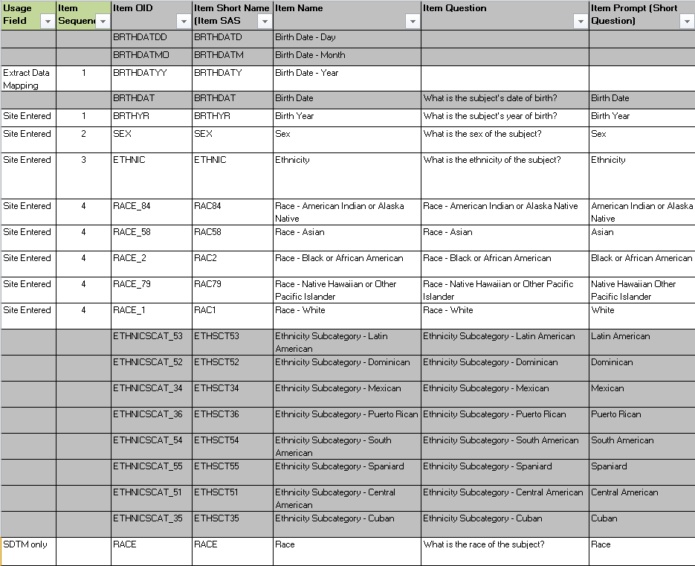
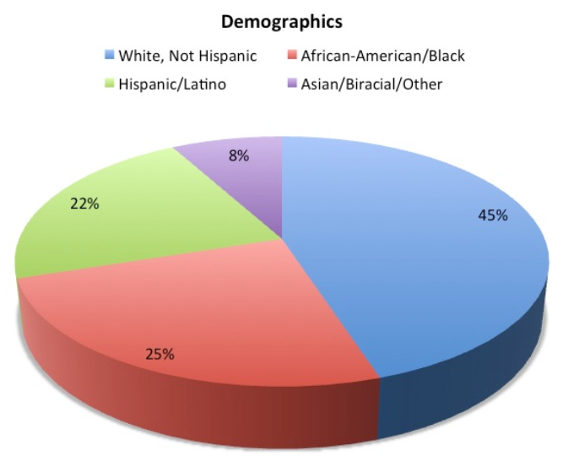
Data Collection Specifications (DCS)
Look familiar?

Slide 7
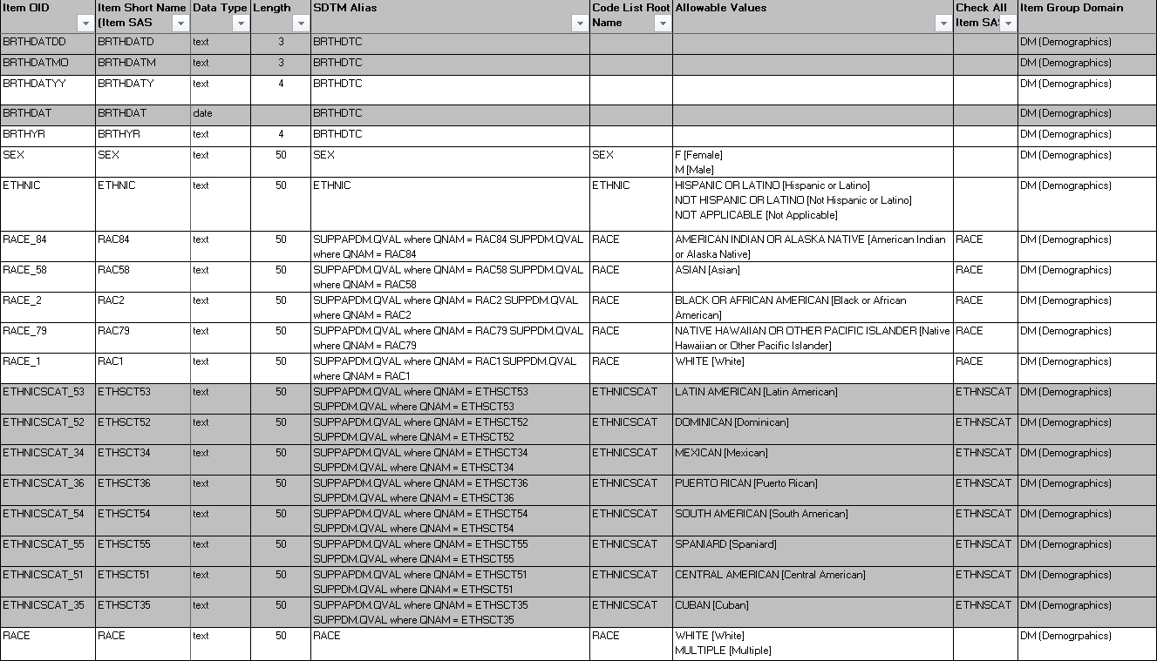
SDTM Alias and Domain

Slide 8
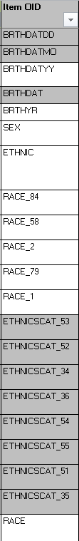
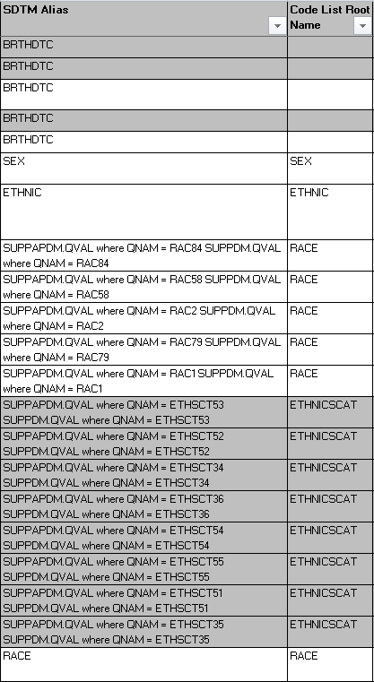
CRF Variables → SDTM Variables
BRTHDATDD, BRTHDATMO, BRTHDATYY, BRTHDAT, BRTHYR → BRTHDTC
RACE_84, RACE_58, RACE_2, RACE_79, RACE_1, RACE → RACE

Slide 9
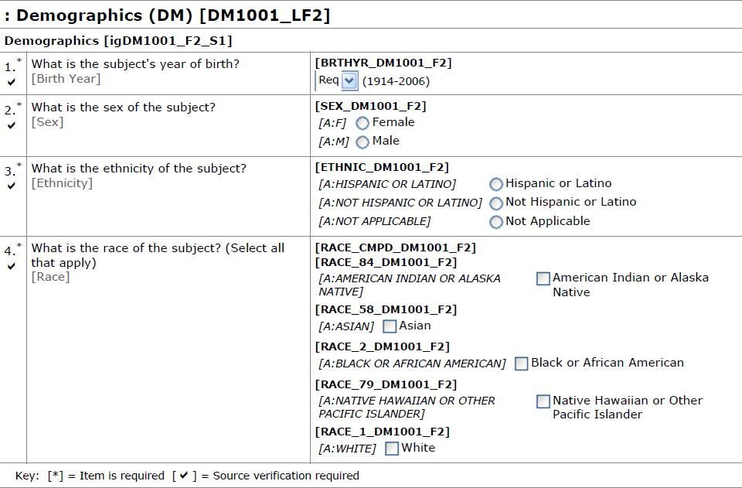
CRF Build Library Form [DM1001_LF2]
BRTHYR → BRTHDTC
RACE_84, RACE_58, RACE_2, RACE_79, RACE_1 → RACE
Notes:
Can be build ahead of time. Or can be built within a study and then promoted to a library.
What is in the Document Library: Picture of the DED and not arranged how it would be arranged on the CRF. Not the same as in the InForm system. Shows every possible collection field available.

Slide 10
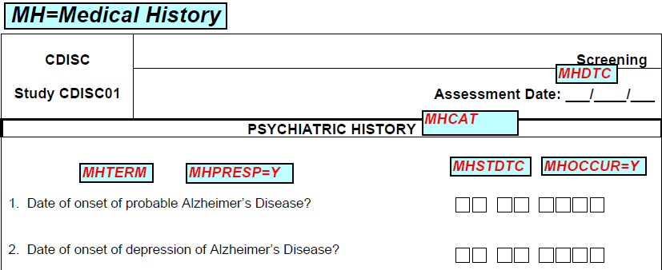
End Product: Example aCRF.pdf

Slide 11
CDA Module 2 Exercise #1 Find Mistakes on an aCRF.pdf for DM

Slide 12
CDA Mod 2 Exercise #1
Review the annotated CRF on the next slide and compare the annotations to the “Core_DED_DM1001_V8” standard (on SDTM Workshop Wave 1 collab site)
Record any issues that are discovered
Issues can include variable names, color, font
Jump to Answer

Slide 13
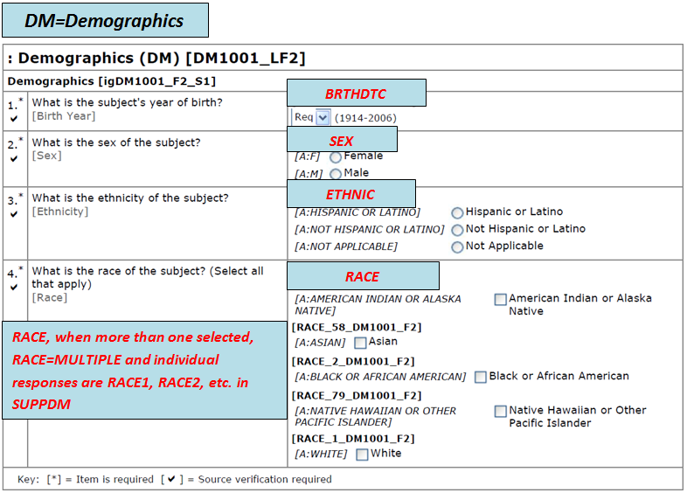
Check aCRF for Mistakes
DM=Demographics
BRTHDATYY
SEX
ETHNIC
RACE
RACE, when more than one selected, RACE=first response (ex. RACE1) and the remaining responses (ex. RACE2, RACE58, etc.) go to SUPPDM

Slide 14
Answer
DM=Demographics
Should be BRTHDTC
BRTHDATYY
SEX
Background color must match “DM= Demographics” annotation
ETHNIC
Extra credit
RACE
RACE should be red & in italics
RACE, when more than one selected, RACE=first response (ex. RACE1) and the remaining responses (ex. RACE2, RACE58, etc.) go to SUPPDM
RACE=MULTIPLE and individual responses (RACE1, RACE2, etc.) go to SUPPDM annotation

Slide 15
FDA Resources

Slide 16
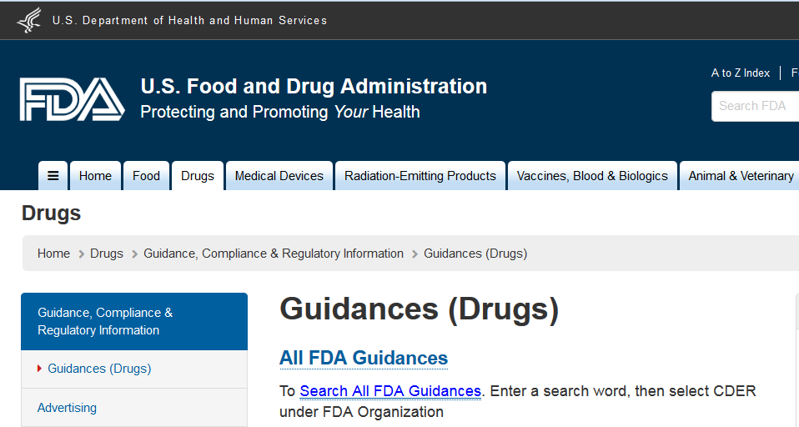
FDA Web Site
http://www.fda.gov/Drugs/GuidanceComplianceRegulatoryInformation/Guidances/default.htm

Slide 17
FDA Standards Timeline
Common Issues Document*
Created help guide to address common issues with SDTM submissions
Guidance Approved
Guidance that allows FDA to require data standards
SDTM Reference
SDTM recommended for regulatory submissions – first study data specs
2004
2009
2010
2012
2014
2016
Computational Science Center
Created new office at FDA to support tools and standards
Study Data Specs V2.0*
Rewrite referencing SDTM, ADaM and Define.xml
MUST COMPLY
Companies must comply within 2 years of approval
* Superseded by Study Data Technical Conformance Guide v2.2 in Jun ‘15
http://www.fda.gov/

Slide 18

FDA and PDUFA V
The Prescription Drug User Fee Act (PDUFA) was enacted in 1992 and renewed in 1997 (PDUFA II), 2002 (PDUFA III), 2007 (PDUFA IV), and 2012 (PDUFA V)
It authorizes FDA to collect fees from companies that produce certain human drug and biological products
PDUFA V: Fiscal Years 2013 – 2017: Requires Electronic Submissions and Standardization of Electronic Application Data

Slide 19
FDA Documents – Dec 17, 2014*
Providing Regulatory Submissions In Electronic Format – Standardized Study Data*
The FINAL word on FDA Submissions must be “electronic” and must use “CDISC Standards”
Data Standards Catalog (Ongoing Updates)
Gives list of Standards the FDA will accept and dates they will accept them
Study Data Technical Conformance Guide* (Technical Specifications Document)
Non-binding reference

Slide 20
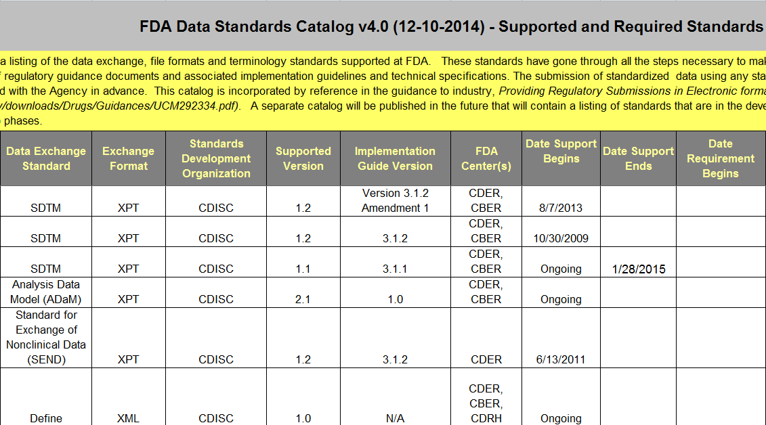
Standards Catalog Screen Shot

Slide 21
CDISC SDTM Overview

Slide 22
SDTM Basics: Domains & Classes
Domains:
Observations about study subjects are collected in a series of domains
Domains are a collection of logically related observations
Single dataset and two- character code (e.g., AE)
Observation Classes:
Categories of domains
Most domains are part of three main classes: Events, Interventions, or Findings
Class
(e.g., Events)
Domain (e.g., AE)
Domain (e.g., DS)
Domain (e.g., MH)

Slide 23

Class: Special Purpose
Special purpose domains are domains that do not conform to one of the three general observation classes (Interventions, Events, Findings)
CO
Demographics
Subject Elements
Subject Visits
SE
SV
Comments
DM

Slide 24
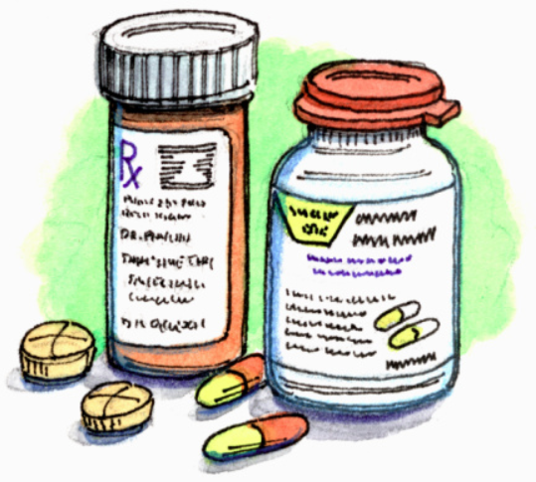
Class: Interventions
Intervention domains capture investigational, therapeutic, and other treatments administered to patient
Think…“Did something happen to your body”?
CM
Exposure
Exposure as Collected
Procedure
EC
PR
Concomitant and Prior Medications
EX
SU
Substance Use

Slide 25


Class: Events
Captures planned protocol milestones such as randomization, study completion, occurrences, or incidents independent of study evaluations or prior to trial
AE
Clinical Events
Disposition
Protocol Deviations
DS
DV
Adverse Events
CE
HO
Healthcare Encounters
MH
Medical History

Slide 26

Class: Findings
Captures the observations resulting from planned evaluations to address specific tests or questions such as labs, ECG, and questions on a questionnaire
DA
Death Details
ECG Results
EG
Drug Accountability
DD
All Findings
21 Findings Domains TOTAL
…
…

Slide 27

Class: Findings About
Intended to be used when collected data represents “findings about” and Event or Intervention that cannot be represented within an Event or Intervention
FA
Findings About
SR
Skin Response

Slide 28
Three Main Types of Classes
Results of Tests: Think Labs, Vital Signs, Questionnaires, etc.
Interventions
xxTESTCD = Short Name of Measurement, Test or Examination
Findings
Events
Treatments: Think Con Meds, Exposure, Procedures, etc.
xxTRT = Name of Treatment
xxTERM = Reported Term for the type of Event/Milestone
Events that may not happen to all subjects or Planned Protocol Milestones: Think Adverse Events, Disposition, etc.

Slide 29
SDTM Implementation Guide (SDTM IG)

Slide 30
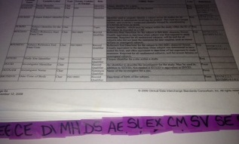
Where to Start with SDTM IG
Print out the SDTM IG (current version)
Add Sticky Notes to every domain
This will be HOMEWORK prior to next workshop; but, you can start now

Slide 31
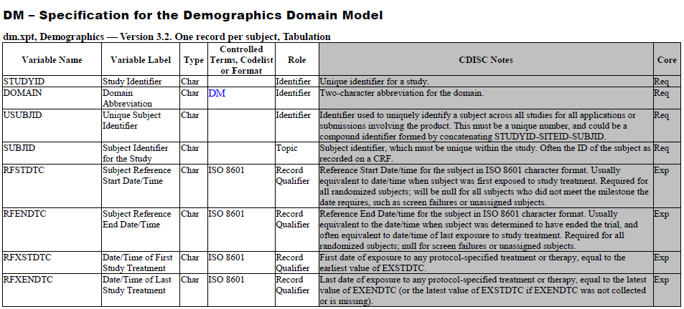
CDISC Demographics (SDTM.DM)
This is only a partial screen shot of the SDTM DM domain from the SDTM IG. Please refer to the SDTM IG for the entire DM domain

Slide 32
SDTM Variable Name
Variable Name (limited to 8 characters)
Variables used in multiple domains or in just one domain will NOT begin with the two-letter domain name
Variables only used in a given domain will begin with the two-letter domain name
Variable Name
USUBJID
ACTARMCD
ACTARM
COUNTRY
DMDTC
DMDY
What domain is this?

Slide 33
SDTM Variable Label & Type
Variable Label (up to 40 characters, must be unique)
Type (e.g., character or numeric)
VARIABLE | VARIABLE LABEL | TYPE | Example Data
USUBJID | Unique Subject Identifier | Char | ABC-1001
SUBJID | Subject Identifier for the Study | Char | 1001
BRTHDTC | Date/Time of Birth | Char | 1975-MAY-10
AGE | Age | Num | 39

Slide 34
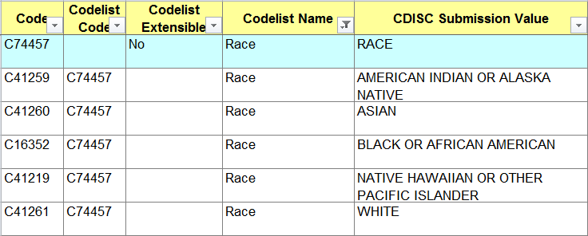
SDTM Controlled Terminology (CT)
All possible values of a variable
CDISC Terminology is based on National Cancer Institute (NCI) http://www.cancer.gov/cancertopics/cancerlibrary/terminologyresources/cdisc

Slide 35
SDTM Core
Required (Req) – Variable MUST be included in domain and cannot have a missing value
Expected (Exp) – Variable MUST be included in domain but can have missing values
Permissible (Perm) – Sponsor determines if permissible variables are included in a domain. These variables can have missing values
VARIABLE | CORE
STUDYID | Req
RACE | Exp
ETHNIC | Perm

Slide 36
CDA Module 2 Exercise #2 Compare SDTM.DM to Lilly DM Standard

Slide 37


CDA Mod 2 Exercise #2
Use “CDA Mod 2 Exercise” template (a portion of the Lilly DM Standard)
Use SDTM.DM (hard copy) as a resource
First complete the column “Core” in “CDA Mod 2 Exercise” template
Then compare CDISC SDTM.DM to Lilly DM Standard:
VARIABLE
VARIABLE LABEL
TYPE
CONTROLLED TERMINOLOGY
CORE

Slide 38
How to Complete “CORE” Column
Open Exercise Template
Values in CORE column are to be based on the Lilly Standard columns:
VARIABLE_REQUIRED
VALUE_REQUIRED
Value of CORE can be “Req” “Exp” or “Perm”
VARIABLE_REQUIRED | VALUE_REQUIRED | CORE
Y | Y | Req
Y |  | Exp
 |  | Perm

Slide 39
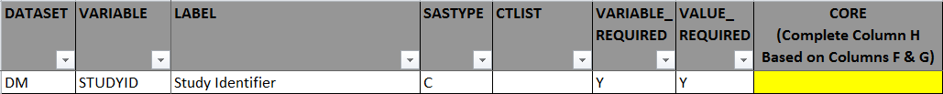
Let’s Try the First One Together
What is the value of CORE?
Compare hard copy SDTM IG to above Lilly Standard. Any differences?
No, SDTM IG and Lilly DM Standard match for STUDYID
See SASTYPE: “C” and “Char” mean the same thing
Remember:
Req – MUST be included in domain and cannot have a missing value
Exp – MUST be included in domain but can have missing values
Perm – Sponsor determines if permissible variables are included in a domain. These variables can have missing values
Req

Slide 40
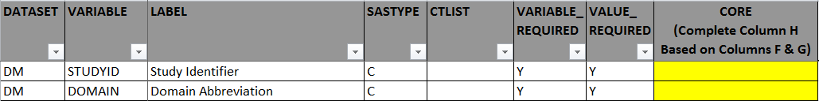
Let’s Try the Next One
What is the value of CORE?
Compare hard copy SDTM IG to above Lilly Standard. Any differences?
Yes, see CTLIST
SDTM IG = “DM”
Lilly DM Standard is missing
Although they are different, Lilly accounts for the names of the domains when it comes time to the FDA Submission
Req
Req
Go Back

Slide 41
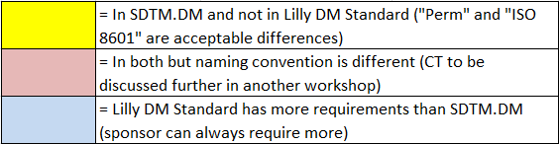
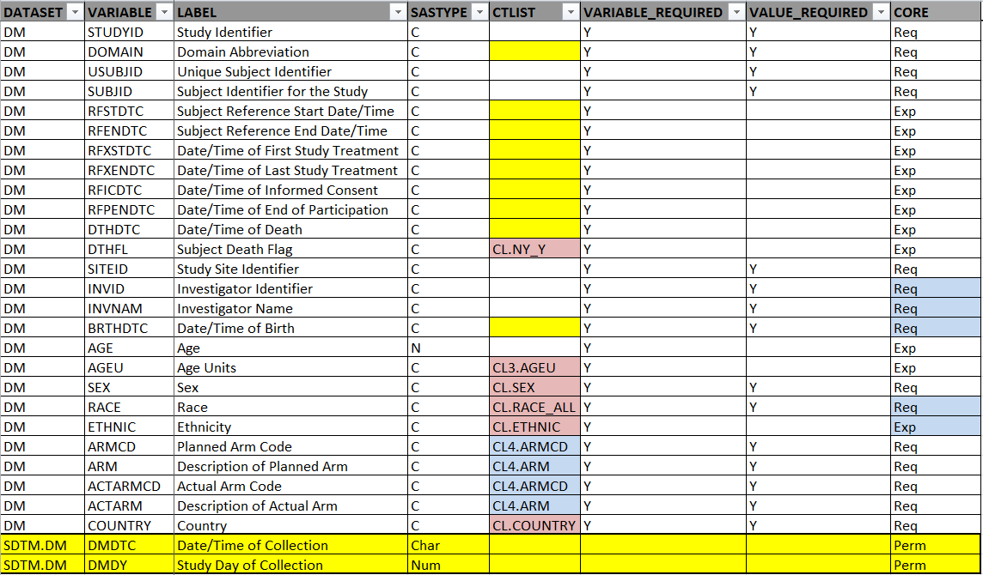
Answer

Slide 42
Summary
CDA processes and tools (CRF Reuse Listing, Data Collections Specs, and CRF Build Library) can be used to
Map to SDTM variables
Annotate a CRF with SDTM variables (aCRF.pdf)
FDA regulations require electronic standard submissions within 2 years of Dec. 17, 2014
SDTM data sets are defined by Classes and Domains
Lilly uses the SDTM IG plus add sponsor defined requirements and controlled terminology

Slide 43
End of CDA Module 2 ☺

